Slide 1
Sales Performance Analysis
Dashboard Analysis using Excel & Power BI”

Slide 2
“The objective of this project is to analyze Sales Performance data, identify key performance metrics, create interactive dashboards, and present insights that help understand product performance, revenue trends, and customer demand.”
PROBLEM STATEMENT

Slide 3
DATASET OVERVIEW
Column Name | Description
Date | Transaction date of sale
Product | Name of the product sold
Category | Product group / classification
Quantity | Number of units sold
Sales | Total revenue generated
Profit | Margin earned from sale (if available)
Region | sales performance across different locations.

Slide 4
DATA CLEANING SUMMARY
Removed duplicates
Removed null values
Fixed date formats
Standardized category names
Computed new fields (if needed):
Total Sales
Profit Margin
Sales per Unit
Verified data types for Sales, Quantity, Profit

Slide 5
KPI SUMMARY
Total Sales
Total revenue generated from all sales transactions within the selected period.
This KPI represents overall business performance and income.
Total Orders
Total revenue generated from all sales transactions within the selected period.
This KPI represents overall business performance and income.
Sales YTD (Year-To-Date Sales)
Total revenue generated from all sales transactions within the selected period.
This KPI represents overall business performance and income.
Total Profit
Total revenue generated from all sales transactions within the selected period.
This KPI represents overall business performance and income.

Slide 6
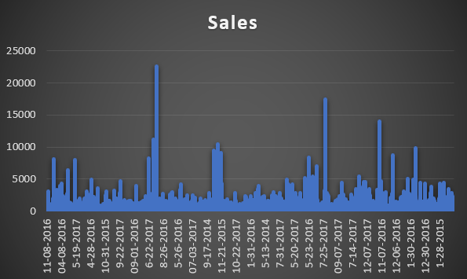
MONTHLY SALES TREND

Slide 7
TOP 10 HIGH-PERFORMING PRODUCTS

Slide 8
SALES BY CATEGORY

Slide 9
SALES BY REGION

Slide 10
DASHBOARD BLUEPRINT (POWER BI LAYOUT)
Title of project
Total sales | Total orders | Sales YTD | Total profit
Sales Trend
Sales by segment
Sales by category
Sales by Region
Total sales

Slide 11
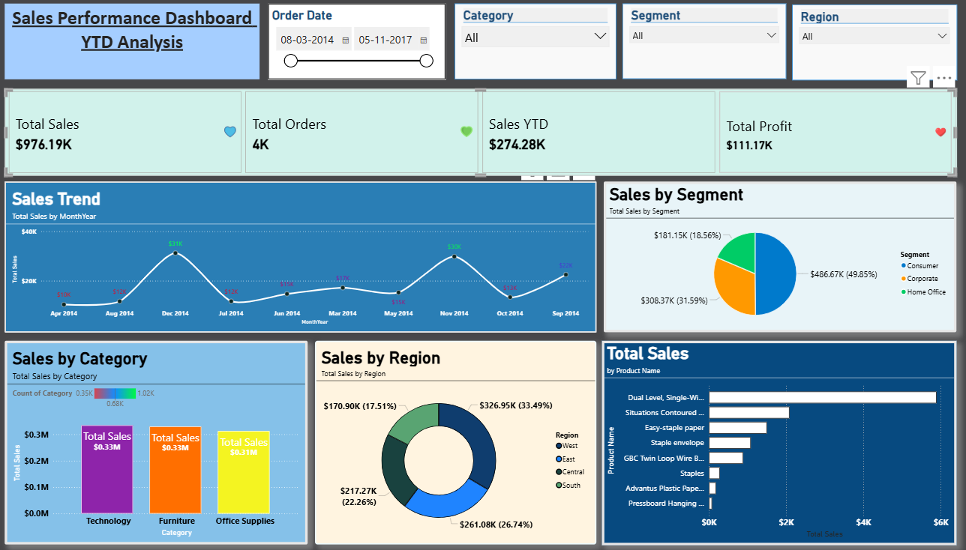
FINAL DASHBOARD SCREENSHOT

Slide 12
INSIGHTS
Monthly sales show upward trend in Q3
Product X generates the highest revenue
Region Y underperforms consistently
Category A contributes 45% of total sales
Profit margin improved compared to last quarter
Top 10 products = 70% of total revenue

Slide 13
CONCLUSION
“This sales performance analysis identifies key products, regional opportunities, and revenue patterns. The interactive dashboard enables managers to make informed business decisions instantly.”

